Slide 1
Dive Into Managed Instances
Getting up to speed with what Managed Instance is and what you need to make use of it.

Slide 2





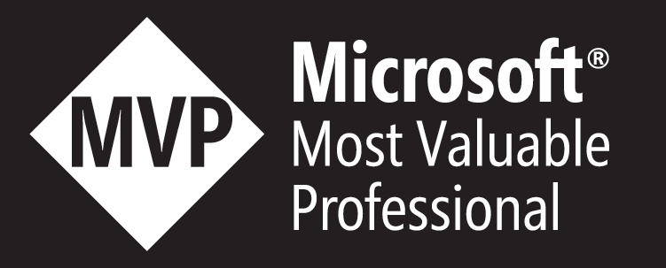
About Me
John Q. Martin
Over a decade of experience working with data platform technologies.
Development, Operations, and Business Intelligence experience.
International speaker
PASS Director at Large
@SQLDiplomat
/JohnQMartin
John@jqmconsulting.com

Slide 3











Slide 4


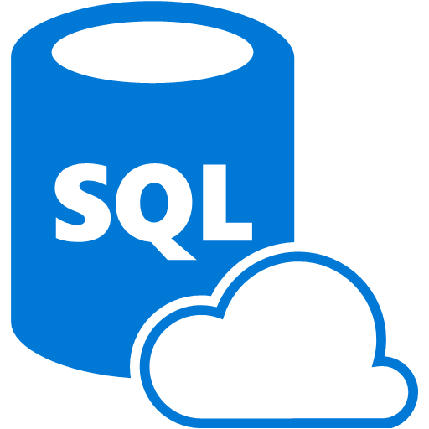
What are Managed Instances?
SQL Server
IaaS | Windows | Linux
PaaS
Retail
Azure SQL DB
On-premises – Physical/Virtual
IaaS VMs (Azure, Google, AWS)
RDS for SQL Server

Slide 5
Versions of Managed Instance
General Purpose
Business Critical
Similar architecture to Failover Cluster Instance.
Leverages Azure storage for databases.
Use for higher capacity scenarios.
Similar architecture to Availability Group.
Local SSD Storage used for user databases.
Use for higher performance workloads.

Slide 6
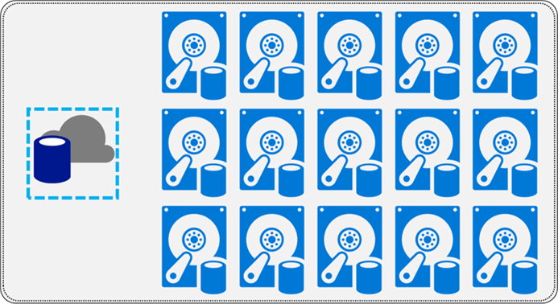
Managed Instance – Architecture
Azure Premium Storage Disks
Stateless Compute
One Database File per-disk
Notes:
Image source for architecture layout from “Introduction to Azure SQL Database Managed Instances” by John Q. Martin (me) for MSSQLTips - https://www.mssqltips.com/sqlservertip/5400/introduction-to-azure-sql-database-managed-instances/

Slide 7
Azure Premium Storage Information
Premium Disks Type | P10 | P15 | P20 | P30 | P40 | P50 | P60 | P70 | P80
Disk Size (GB) | 128 | 256 | 512 | 1024 | 2048 | 4096 | 8192 | 16,384 | 32,767
IOPS per Disk | 500 | 1,100 | 2,300 | 5,000 | 7,500 | 7,500 | 12,500 | 15,000 | 20,000
Throughput per disk (MB/s) | 100 | 125 | 150 | 200 | 250 | 250 | 480 | 750 | 750
100 GB File = P10 Disk
Bigger files will give better throughput, even if they are empty.
500 GB File = P20 Disk
1.5 TB File = P40 Disk
Source: https://docs.microsoft.com/en-us/azure/virtual-machines/windows/premium-storage
Notes:
Performance chart for Azure Disks obtained from Microsoft Documentation : https://docs.microsoft.com/en-us/azure/virtual-machines/windows/premium-storage
Storage performance for Managed Instance relies on the a number of factors, you can find out more information on how to achieve high performance in this blog post from Microsoft -https://blogs.msdn.microsoft.com/sqlcat/2018/07/20/storage-performance-best-practices-and-considerations-for-azure-sql-db-managed-instance-general-purpose/

Slide 8

Managed Instance – Architecture

Slide 9
Creating A Managed Instance
Networking
Resource usage
Time zones
Identity
Source: https://docs.microsoft.com/en-us/azure/virtual-machines/windows/premium-storage

Slide 10





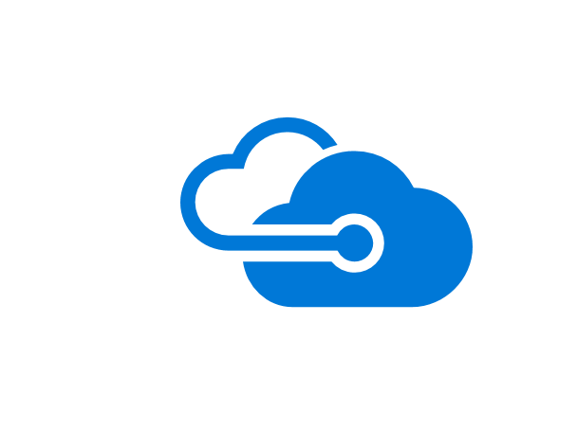
Managed Instance – Architecture
Source: https://docs.microsoft.com/en-us/azure/virtual-machines/windows/premium-storage

Slide 11
Migration Options
Backup & Restore
Data Migration Service
Transactional Replication
Source: https://docs.microsoft.com/en-us/azure/virtual-machines/windows/premium-storage

Slide 12
Migration Preparation
Trace your Workloads
Understand what features are in use and whether there needs to be updates in order to migrate.
Feature Utilization
Is the feature-set in use compatible with those of Managed Instance?
Profile and Document the Environment
Identify dependencies on the database tier, are they compatible with Managed Instance.
Understand the business needs for migration down-time tolerance.

Slide 13
Migration Preparation
Identify instance scoped artefacts
Migration of Jobs, Credentials, Logins, Linked Servers, etc.
Outside of the database these will need to be moved manually.
Map the new environment
Placement of application components and connectivity requirements.
Hybrid or Cloud post-migration?
Is Azure Active Directory (AAD) needed?
Do you need Azure AD Connect configured to sync users etc. to AAD to be able to use AAD Authentication?
Notes:
One of the key things to understand with the database migration process if you are leveraging AAD for authentication is that the SID for the server level login will not be the same as on-premises. As with database migrations where SQL Authentication is being used, you will need to handle the mismatch in SID between the database user and Instance Login.
Rip and replace for Database level security mapping. This is only really viable if leveraging database roles for granular permissions, otherwise it can be difficult to map and then test that user level securables are removed and replaced as they should be.
Use ALTER USER to link database user to appropriate login from Azure Active Directory. This will link the database level user to the server login, performing the same functionality that used to be provided by sp_change_users_login.
One of the key elements when it comes to authentication for the Managed Instance is that the application can support using AAD authentication. If this is not the case then there is a need for reverting to SQL Authentication.
Migration of Instance level objects can be performed via SSIS or other open source tools such as DBATools.
Azure AD Connect
https://docs.microsoft.com/en-us/azure/active-directory/connect/active-directory-aadconnect
DBA Tools
https://dbatools.io/

Slide 14


Useful Free Tools
Chrissy LeMaire | @CL
Gianluca Sartori @Spaghettidba
DBATools - https://dbatools.io
PowerShell module that will help with scripting and automation for migration processes.
WorkloadTools - http://bit.ly/WorkloadTools
GitHub project from Gianluca Sartori for analysis and replay of workloads.
Live replay from one server to another via XE or Trace Capture.
XESmartTarget - http://bit.ly/XESmartTarget
Analyse live XE session data.

Slide 15
Migration Preparation
Physical Database Architecture
Understand files, filegroups, and log file properties.
Identify up-stream and down-stream dependencies
Application connectivity, ETL pipelines, Authentication mechanisms.
Instance and external dependencies
What will need to be migrated separately from the database, pre/post migration.
Tune workloads before moving them

Slide 16
Adopt a Cloud Mindset
Management is largely handled
Focus on what you can control
Platform as a Service is different
Resource usage is going to be higher
Extra capacity is wasted money
Get as much bang for your buck as possible
Tune first
Optimize workload to minimise spend
Co-locate workloads where possible

Slide 17









Migrating to Managed Instance
Site 1
Availability Group 01
VPN
Site 2
Azure
Notes:
Migration of database elements from on-premises (or IaaS VMs) retail SQL Server to Azure SQL Database Managed Instance necessitates backup to URL from the source. This is then restored to the Managed Instance using the standard RESTORE DATABASE command, however there is no need for mapping storage paths etc. using MOVE as this is handled natively by the Managed Instance.
Once the database components are migrated to the Managed Instance, the application level components can be migrated if needed. Either creation of new IaaS VMs and installing the software as needed, or migrating existing VMs to Azure using Azure Migration Service.
Where the databases to be migrated are very large, there are options to mitigate lack of bandwidth and time. The Azure Import/Export service allows data to be stored on SATA disks that can then be sent to Microsoft and loaded to Azure Blob Storage. Leveraging this capability as part of the migration plan has a lot of potential to ease the pain of large database migrations.
Another option is to use Transactional Replication to seed the Azure SQL Database Managed Instance ahead of the migration and cut-over. Managed Instance supports being a Transactional Replication Subscriber.
There are many options that can be used to perform the migration, it is important to evaluate the options and select the one that is most appropriate for your environment.
Azure Migrate
https://azure.microsoft.com/en-gb/services/azure-migrate/
Azure Import/Export Service
https://azure.microsoft.com/en-us/services/storage/import-export/

Slide 18





Migrating to Managed Instance
On-Premises/IaaS
2
PaaS
.bak
.trn
Publisher
1
Subscriber
Distributor

Slide 19
Disaster Recovery Options
Backup & Restore
Auto-Failover Groups
Automated Backups
Source: https://docs.microsoft.com/en-us/azure/virtual-machines/windows/premium-storage

Slide 20

Auto-Failover Groups
Source: https://docs.microsoft.com/en-us/azure/virtual-machines/windows/premium-storage

Slide 21
Maintenance Operations
Backups
Log Analysis
Index and Statistics Maintenance
Source: https://docs.microsoft.com/en-us/azure/virtual-machines/windows/premium-storage

Slide 22
Questions

Slide 23

Session Feedback Day 2 (not optional!)
http://bit.ly/DataGrillen2019Day2

Slide 24

Event Feedback (not optional!)
http://bit.ly/DataGrillen2019Event

